Slide 1
RFID Tag based Sensing
Swadhin Pradhan
09/05/2018

Slide 2
Outline
Physics Refresher
Basics of Electromagnetism
Basics of Antenna Theory
Method of Moments
Primer on RFID Tags
RFID Tag based Sensing
Active
Passive
Conclusion

Slide 3
Physics Refresher

Slide 4
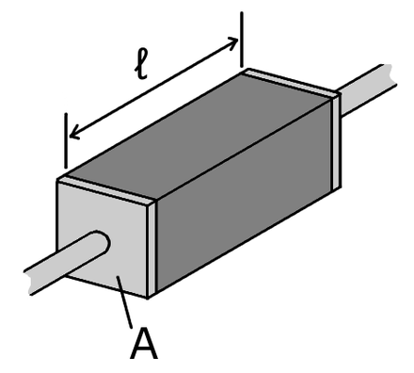
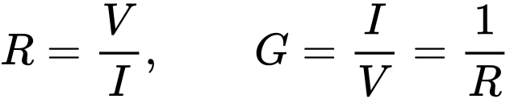
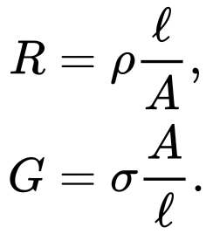
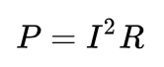
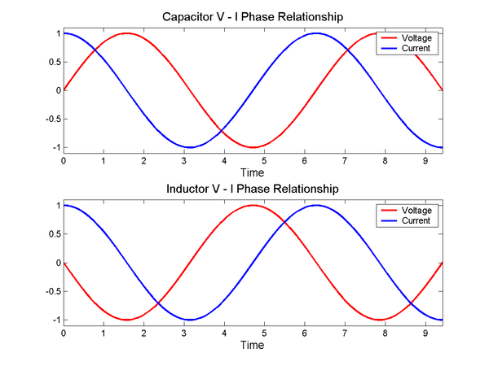
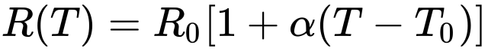
Resistance, Conductance, Impedance, Admittance

Slide 5
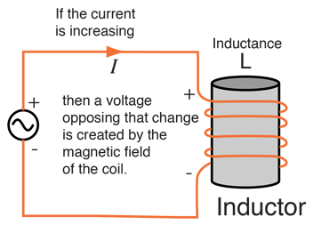
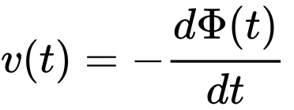
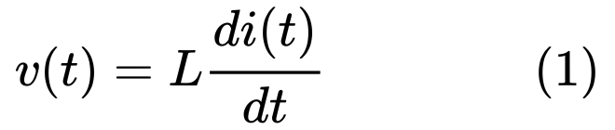
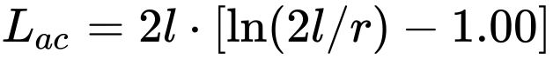
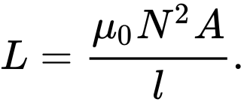
Inductance
Wire
Solenoid

Slide 6
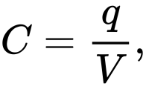
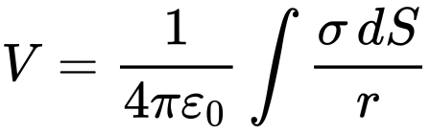
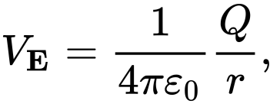
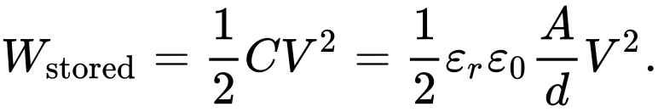
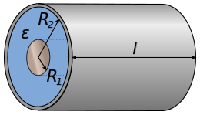
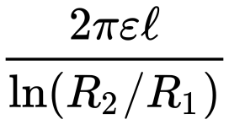
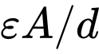
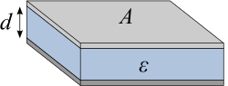
Capacitance

Slide 7
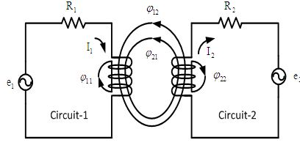
Inductive Coupling
Two conductors are said to be inductively coupled or magnetically coupled when they are configured such that a change in current through one wire induces a voltage across the ends of the other wire through electromagnetic induction.

Slide 8
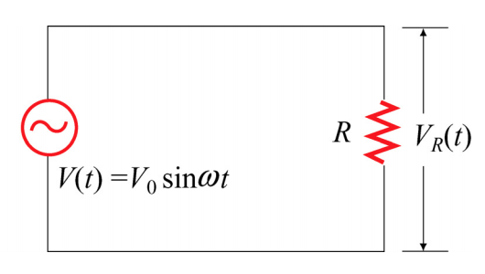
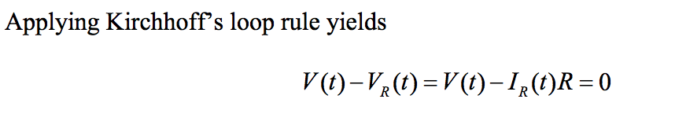
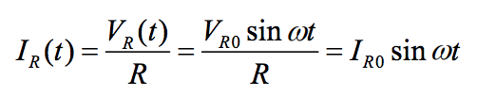
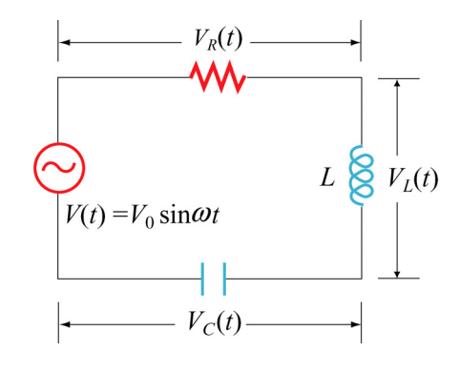
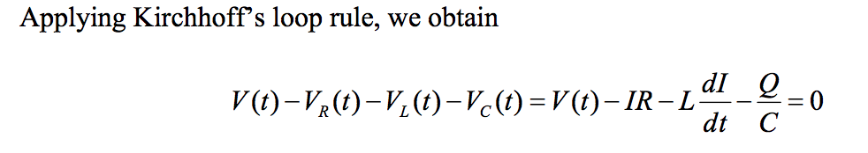
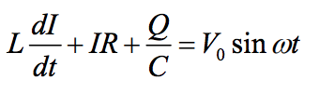
RLC Circuits

Slide 9
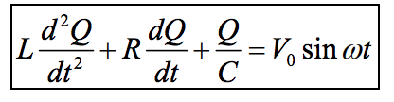
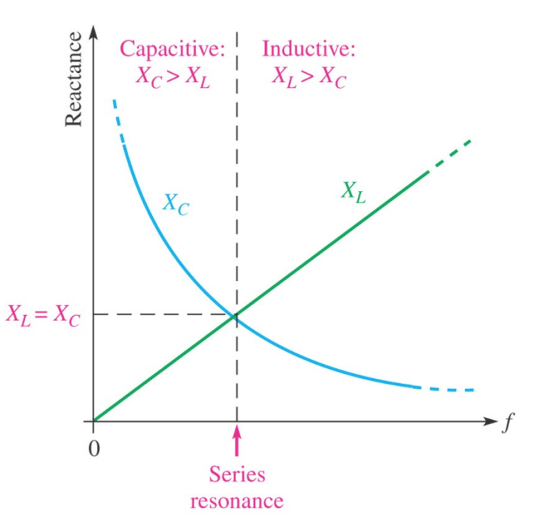
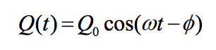
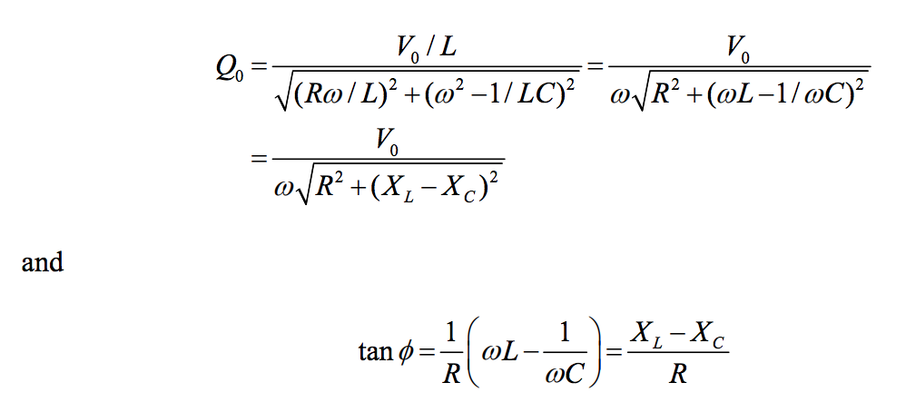
RLC Circuits
The condition of resonance
is characterized by minimum impedance
Notes:
the condition of resonance is straightforward and it is characterized by minimum impedance and zero phase.

Slide 10
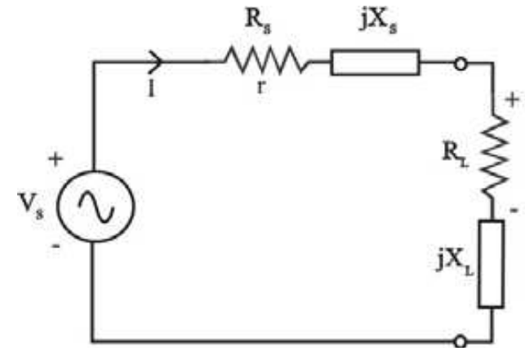
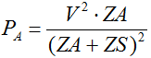
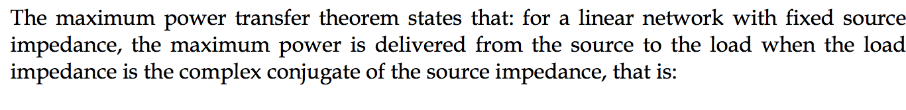
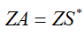
Maximum Power Transfer Theorem

Slide 11
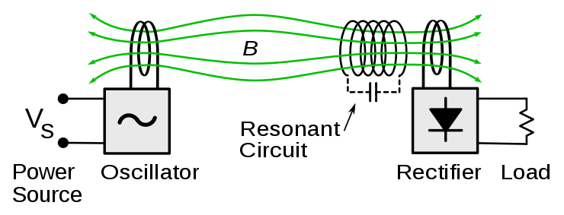
Inductive Resonant Coupling
Inductive resonant coupling or magnetic phase synchronous coupling is a phenomenon with inductive where the coupling becomes stronger when the "secondary" (load-bearing) side of the loosely coupled coil resonates.
Notes:
Wireless Power Transfer – even in RFID – Started with Nicola Tesla

Slide 12
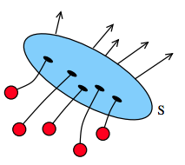
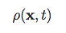
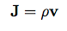
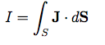
Some Other Terms
Charge Density
Charge per unit volume (Unit is Coulomb/m^3)
Current Density
Density of current in a surface volume, where v is the velocity at point x.
Current
Notes:
Four Forces (Gravity, Nuclear, Electric, Magnetic )
Electromagnetism (EM) = Electric + magnetic
Gravity uses ‘mass’ (+) property and EM uses ‘charge’ (+/-) property

Slide 13
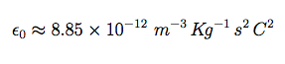
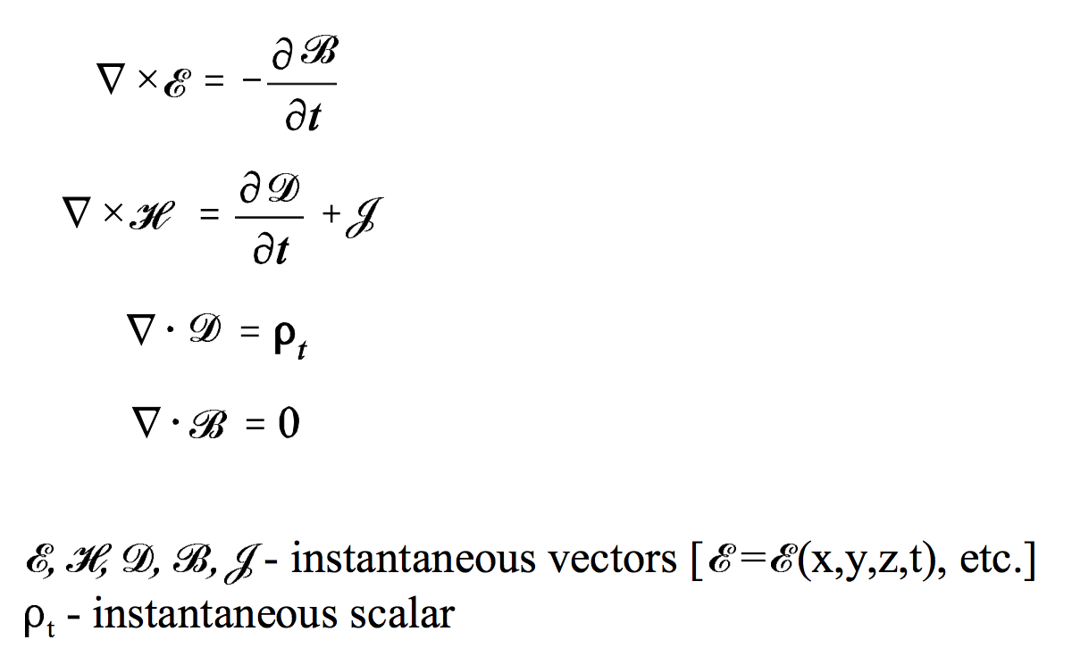
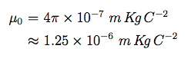
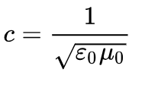
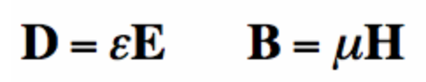
Maxwell’s Equations (Instantaneous Point Form)
Notes:
https://www.youtube.com/watch?v=Dvh28I7bx1w

Slide 14
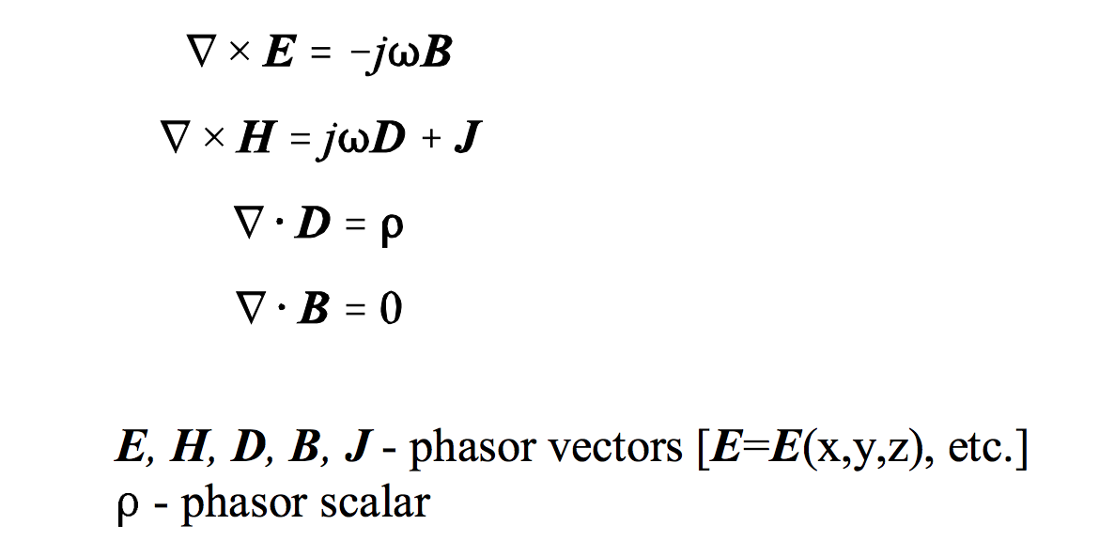
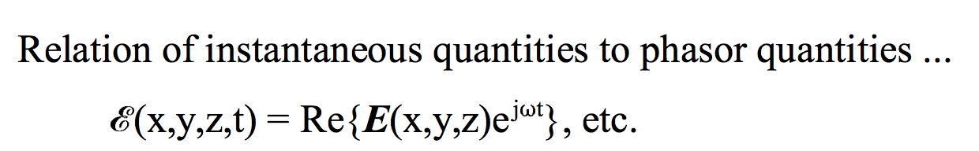
Maxwell’s Equations (Phasor/Time-Harmonic)
Notes:
http://cwi.unik.no/images/2/2b/RadiationPattern.pdf

Slide 15
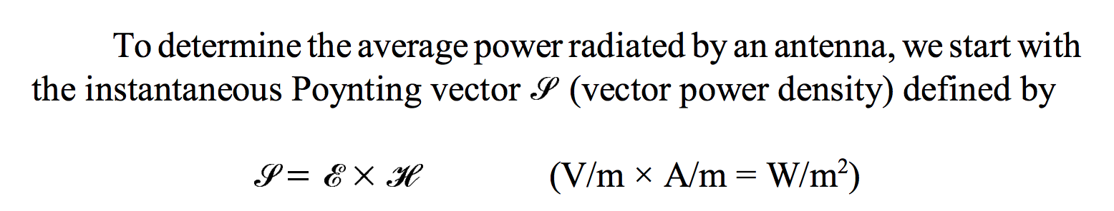
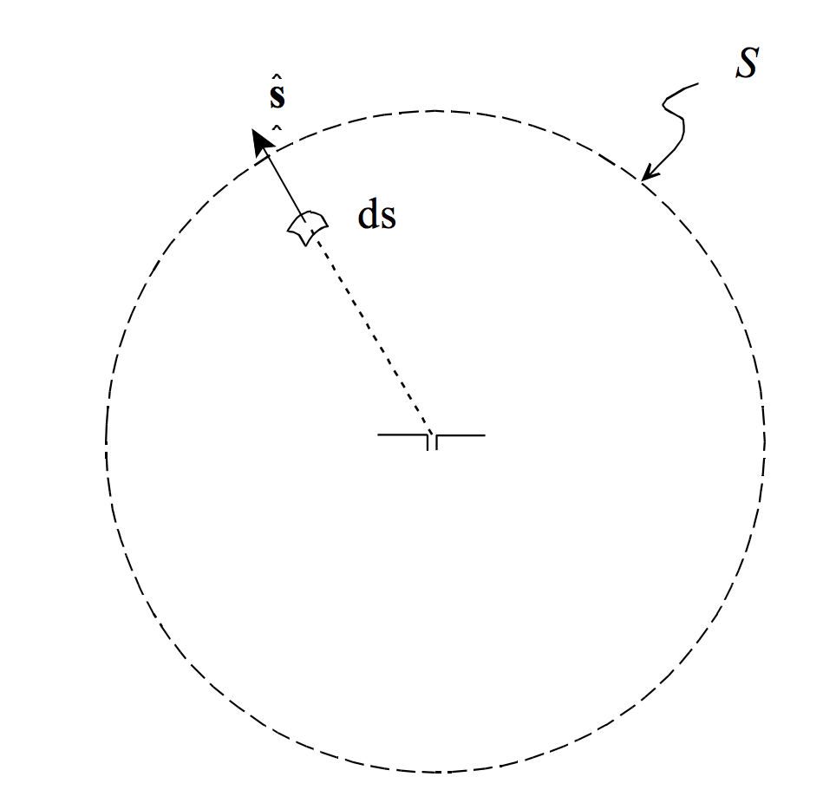
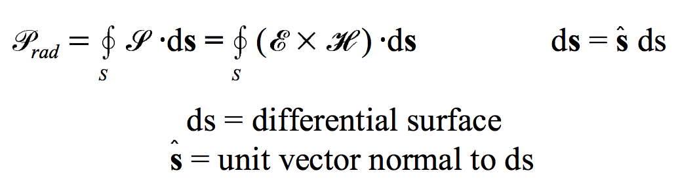
Poynting Vector

Slide 16
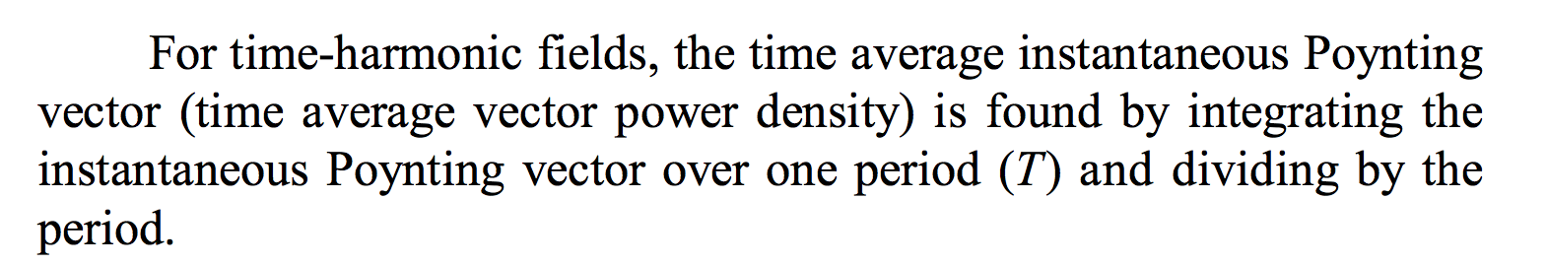

Poynting Vector and Radiated Power

Slide 17

Electromagnetic Wave
This is a synchronized oscillations of electric and magnetic fields that propagate at the speed of light through a vacuum.
EM waves are emitted by electrically charged particles undergoing acceleration. They carry energy, momentum, and angular momentum.

Slide 18
Antenna Theory

Slide 19

Antenna Radiation
All radiation is caused by accelerating charges which produce changing electric fields. And due to Maxwell’s equations, changing electric fields give rise to changing magnetic fields, and hence we have electromagnetic radiation.

Slide 20


Antenna Radiation Pattern
A radiation pattern defines the variation of the power radiated by an antenna as a function of the direction away from the antenna.
This power variation as a function of the arrival angle is observed in the antenna’s far field.

Slide 21


Directional Radiation Pattern

Slide 22

Antenna Radiation Pattern
Notes:
The fields still die off as 1/R, and the power density dies off as 1/R^2. Reactive fields meaning that E and H fields are out of phase. But in far-field they are in-phase.

Slide 23


Directivity of Antenna
It is a measure of how 'directional' an antenna's radiation pattern is. Higher the value, the antenna is more directional.
Normalized radiation pattern:
Notes:
An antenna that radiates equally in all directions would have effectively
zero directionality, and the directivity of this type of antenna would be 1 (or 0 dB).

Slide 24

Directivity of Antenna
Notes:
As a result, small antennas have broad radiation patterns (low directivity), and antennas with large uniform voltage or current distributions have very directional patterns (and thus, a high directivity).

Slide 25


Efficiency, Reciprocity, Gain, Impedance, Bandwidth
The efficiency of an antenna is a ratio of the power delivered to the antenna relative to the power radiated from the antenna.
The efficiency is the same whether we are using the antenna as a transmit or receive antenna. (Antenna Reciprocity)
The term antenna gain describes how much power is transmitted in the direction of peak radiation to that of an isotropic source.
Antenna impedance relates the voltage to the current at the input to the antenna.
Bandwidth describes the range of frequencies over which the antenna can properly radiate or receive energy. (VSWR)
Notes:
If you don’t know the direction always use low gain antenna.

Slide 26

Antenna Pattern Parameters

Slide 27





Antenna Polarization
The polarization of an antenna is the polarization of the radiated fields produced by an antenna, evaluated in the far field.
Notes:
for two linearly polarized antennas that are rotated from each other by an

Slide 28


Effective Aperture of an antenna
Then the effective aperture parameter describes how much power is captured from a given plane wave.

Slide 29






Friis Equation Antenna

Slide 30

Herzian Dipole
The Hertzian dipole or elementary doublet refers to an idealized tiny segment of conductor carrying a RF current with constant amplitude and direction along its entire (short) length.
A real antenna can be modeled as the combination of many Hertzian dipoles laid end-to-end.

Slide 31







Herzian Dipole
ζ₀ = √​^{μ}₀⁄_{ε0}

Slide 32




Types of Antenna : Short Dipole Antenna

Slide 33


Dipole Antenna

Slide 34


Half-wave Dipole Antenna

Slide 35





Wideband Dipole, Monopole
More area Dipole
Ground Half-wave Antenna
Folded Dipole

Slide 36


Loop Antenna
Loop antennas have a very desirable property related to robustness in performance near the human body.
Notes:
To explain this, note that the human body tends to have a large value for permittivity and a bit of conductivity. The permittivity acts on the Electric Field and tends to tune the response of the antenna down in frequency. The conductivity of the body acts as a lossy material and absorbs energy from the antenna; this can severly degrade the antenna efficiency.
The human body affects dipole antennas particularly strongly. This is because in the near field (very close to the antenna), the Electric Fields are particularly strong. The interesting thing though, is the body isn't really magnetic. Hence, the magnetic fields don't really see the body as much, and hence aren't affected like the electric fields are. And because the loop antenna is somewhat the "dual" of the dipole as discussed earlier, the magnetic fields are strong in the near field of the loop antenna. These magnetic fields ultimately give rise to the antenna radiation, and since they are somewhat immune to the human body, loop antennas tend to be much more robust in terms of performance when they are placed near a human. As a result, antennas in hearing aids and other "wearable antennas" are often loop antennas. This property makes loop antennas extremeley useful.

Slide 37


Cloverleaf Antenna

Slide 38




Slot Antenna

Slide 39

Bow-Tie Antenna

Slide 40


Method of Moments
This is accomplished by defining the unknown current distribution Iz(z′) in terms of an orthogonal set of “basis” functions and invoking the boundary conditions.
Notes:
The fundamental concept behind the MoM employs orthogonal expansions and linear algebra to reduce the integral equation problem to a system of simultaneous linear equations.

Slide 41


Method of Moments
The solution procedure begins by defining the unknown current distribution Iz(z′) in terms of an orthogonal set of basis functions.
Testing in boundary conditions with known values: feed gap and surface of the antenna.

Slide 42
RFID

Slide 43

RFID: a Primer

Slide 44

Inductive and Radiating Coupling

Slide 45

Skin Depth – Extent of Penetration of Signal

Slide 46

Skin Depth – Extent of Penetration of Signal
Notes:
the high dielectric permeability of the tissue changes the capacitance of the coil and greatly reduces readability

Slide 47



RFID: a Primer

Slide 48

RFID Tag: A Primer

Slide 49
RFID Tag Types
Active RFID Tag
With Battery
Simpler Reader
Passive RFID Tag
Battery-free
Complex Reader

Slide 50
Types of RFID Tag
Chipped RFID Tag
ASIC chip to modulate
Impedance matching for RFID tag chip antenna
Chip-less RFID Tag
Higher band-width
Frequency notches across frequency
Load-line with resonator spirals

Slide 51




Chip-less RFID Tag

Slide 52



Chip-less RFID Tag

Slide 53




Chip-less RFID Tag

Slide 54
Types of Chipped RFID Tag
LF
125-134 KHz
Low-data rate
Low range
HF
13.56 MHz (~NFC)
UHF
High Data rate
Longer range
Smaller Tags
860 – 930 MHz

Slide 55

Chipped RFID Antenna Design Goals
Matching the Impedance
of antenna with the the
Chip Impedance
Antenna Size Reduction

Slide 56


Chipped RFID Tag

Slide 57






RFID Antenna (T-Match) – Impedance Transformer
Where,

Slide 58




RFID Antenna (Inductively Coupled Loop)
Where,
Notes:
Micro-chips having high-impedance phase angle

Slide 59


RFID Antenna (Nested Slot)

Slide 60


Size Reduction Technique (Meandering)

Slide 61

Meandering

Slide 62


Size Reduction Technique (Inverted F)

Slide 63

Meandering vs Inverted-F

Slide 64
RFID Tag Sensing

Slide 65

RFID Tag Sensing

Slide 66
Parameters to Measure (in Home)
Temperature (Extreme – Fire )
Relative Humidity (Extreme – Water Flood)
Light
Pressure

Slide 67

Main Properties Change
Tag physical property change – Impedance
How to measure:
Frequency Response
Phase
RSS / RCS
Threshold Power

Slide 68







Power Threshold Example

Slide 69

Approaches
Battery-based Active Tag
WISP Tag
Active Sensor Present
Modulate the reading the tag signal

Slide 70
Approaches
Custom Sensor Commercial Passive Tag
RF Micron
Design of an ASIC tag chip which changes the impedance based on the change in environment
Parameter Specific Tag
Around $20-$30

Slide 71
Approaches (Chemical Loading)
Custom designed passive tag which will help change in some parameter
Changing the chemical of the antenna which accentuates that feature
Temperature sensitive material
Humidity sensitive material

Slide 72



Chemical Loading
Example of Tags
Equation :
Eqv. Circuit of Normal Tag
Eqv. Circuit of Chemical Loaded Tag

Slide 73
Approaches
Modifying the current tag
Adding sensor to the tag passively
Attaching some passive extension to the tag

Slide 74


Passive Loading Example (Temp. Binary Sensor)

Slide 75


Displacement and Beverage Level Sensor

Slide 76
Approaches
Use the commercial UHF tag
Change in the reading
Impedance, phase, RSS etc. got changed

Slide 77


Outdoor Tag Experiment

Slide 78

Indoor Tag Experiment in Environment Chamber

Slide 79

Indoor Tag Experiment in Environment Chamber

Slide 80


Communication vs Sensing

Slide 81

Issues
Chip-less
RFID Tag
Range
Robustness
Dynamic Range
Building
Flexibility

Slide 82


Which Feature to extract ?
AID (Analog Identifier) – Ratio
Effect of Environment or Air on the electrical or magnetic property of the material (Permittivity and Permeability) – Deschamps equation

Slide 83

RFID Tag Equivalent Circuit Design

Slide 84

RFID Tag Sensing

Slide 85
Thanks

Slide 86
Discussion and Conclusion

Slide 87




Poynting Vector and Radiated Power
Notes:
http://www.maxwells-equations.com/forms.php
https://www.cv.nrao.edu/course/astr534/AntennaTheory.html

Slide 88
Poynting Vector and Radiated Power
Notes:
http://www.maxwells-equations.com/forms.php
https://www.cv.nrao.edu/course/astr534/AntennaTheory.html

Slide 89



Vector Dot Product

Slide 90




Vector Cross Product

Slide 91

RLC Circuits

Slide 92



RLC Circuits

Slide 93

Thevenin’s Theorem
Any linear circuit containing several voltages and resistances can be replaced by just one single voltage in series with a single resistance connected across the load.

Slide 94

Norton’s Theorem
Any linear circuit containing several energy sources and resistances can be replaced by a single Constant Current generator in parallel with a Single Resistor.

Slide 95



Nabla or Del Function or Gradient
Example
The gradient points to the
direction of greatest increase ->
Local Maxima.

Slide 96


Flux
Flux is the amount of ‘’something’’ passing through a surface.
The total flux depends on the strength of the vector field, the size of the surface it passes through, and their orientation.
Total flux = Field Strength * Surface Size * Surface Orientation
Notes:
+ Flux leaved the closed surface and - Flux enters the closed surface.
Total flux = (Field Strength * dS * Orientation) for every dS.
Total flux = Integral (Field Strength * Orientation * dS)

Slide 97


Magnetic Flux Lines
Magnetic Field
Impact of Non-magnetic Material
Impact of Magnetic Material
Notes:
http://www.isu.edu.tw/upload/52/35/files/dept_35_lv_2_7895.pdf

Slide 98



Divergence
Divergence or div is flux density.
Total flux change = (field change in X direction) + (field change in Y direction) + (field change in Z direction)
Notes:
https://betterexplained.com/articles/flux/
https://betterexplained.com/articles/divergence/
https://betterexplained.com/articles/vector-calculus-understanding-circulation-and-curl/

Slide 99


Magnetic Flux Density
Magnetic Flux Density
Unit: Tesla, Weber/m^2

Slide 100




Curl
Circulation is the amount of "pushing" force along a path. Curl is the amount of pushing, twisting, or turning force when you shrink the path down to a single point.

Slide 101



Maxwell’s Equations (Point form)
Electric constant or Electric Permittivity in Vacuum
Magnetic permeability constant means how easily
magnetic field can go through
Notes:
Source: https://www.cv.nrao.edu/course/astr534/AntennaTheory.html
The above equations are known as "point form" because each equality is true at every point in space.
B – Magnetic Field, H is the Magnetic field Strength, Km is the relative Permeability

Slide 102





Some Other Terms
Field is dynamical quantity depending upon space and time: Three dimensional electric field E(x,t) and Magnetic Field B(x,t)
Electric charge is locally conserved. Charge density can change if there is a compensating current flow in the region.
Lorenz force law:

Slide 103

Polarity of Induced Voltage
Notes:
http://www.isu.edu.tw/upload/52/35/files/dept_35_lv_2_7895.pdf
http://jenko.eu/marjan/fpp_izredni/Knjiga_PoEE/PoEC_10__Magnetism_and_Electromagnetism.pdf

Slide 104





RFID : a Primer

Slide 105


Notes:
Friis Equation: http://www.antenna-theory.com/basics/friis.php

Slide 106

Radio Cross Section of a Tag

Slide 107

Electromagnetic Induction
When a conductor is moved through a magnetic field, a voltage is induced across the conductor : This is electromagnetic induction.
The faster the movement, the greater the induced voltage.
Notes:
Physics Formulae:
http://www.concepts-of-physics.com/resources/general/image/formulae-sheets-for-physics-2017-1.pdf
https://www.farmingdale.edu/faculty/peter-nolan/pdf/UPCh29.pdf

Slide 108

Ideal Hertz Dipole

Slide 109



Half-Wave Dipole Antenna and Standing Wave

Slide 110

Dual-band and Dual Polarization Tags
Notes:
Higher order harmonics

Slide 111


Slotted Wave-guide Antenna

Slide 112

Tag Bandwidth Issues for Size Reduction

Slide 113

Antenna Radiation Pattern Calculation

